Slide 1

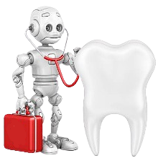
Dentel Intelligence System : An AI-Based Diagnostic Platform for Dental X-ray Analysis Supervised by :Dr. Amal Aboutabl

Slide 2
Table of contents
06
Age & Gender Classification
01
Introduction & Motivation
Teeth Detection, Numbering
& Disease Detection Models
02
Problem Statement
07
Real-World Impact
Across Stakeholders
Best Results &
Comparative Analysis
03
08
04
Related Work
09
Web Application
Datasets & Tools
10
Conclusion & Future Work
05
11 Meet Our Team

Slide 3
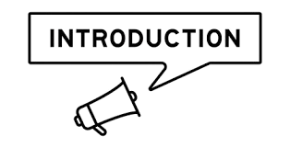
Introduction & Motivation
01

Slide 4
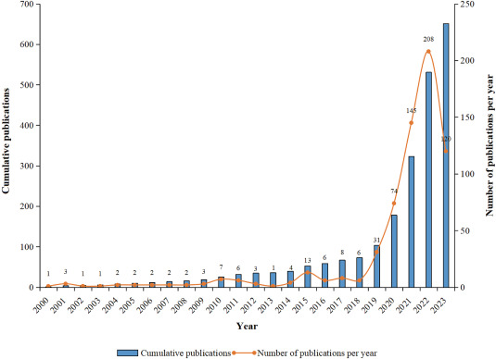
The Rise of AI in Medicine
🧬 Evolution of AI in Healthcare:
From cancer detection to robotic surgery, AI is transforming medicine.
AI is revolutionizing healthcare by automating diagnostics, treatment planning,
and data analysis.
In dentistry, AI enhances image interpretation and clinical decision-making.
Dental X-rays are ideal for AI analysis due to their structural patterns and diagnostic importance.

Slide 5
Why Automate Dental Diagnostics?
⏱️ Faster Diagnosis AI processes dental X-rays in seconds, reducing diagnostic time dramatically.
🔍 Improved Accuracy Deep learning models can detect subtle patterns in X-rays that may be missed by the human eye
💰 Cost Efficiency
Saves costs for clinics and patients alike.
Decreases need for manual interpretation and follow-up tests.
📈 Early Detection of Diseases Enables identification of dental diseases at early stages, improving treatment outcomes.
👥 Support for Dentists Acts as a decision-support tool to assist dentists in complex cases.
🌐 6. Scalable and Remote Access
Integrated into a web-based platform using React & .NET.
Supports remote diagnosis and educational use (Doctors, Students).

Slide 6

Problem Statement
02

Slide 7
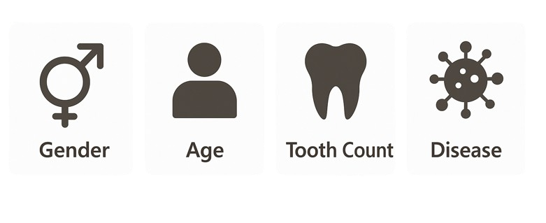
What We Solve ?
🛠️ 5 Key Problems Addressed:
1️⃣ Gender Detection
Classify the patient's gender (Male or Female) using panoramic dental X-rays.
2️⃣ Age Group Detection
Detect whether the patient is a Child or Adult based on tooth development and bone structure.
3️⃣ Teeth Disease Detection
Identify dental abnormalities such as caries, implants, and root canal issues using image-based detection. 🦠 Targeted Diseases: ['Caries', 'Crown’, 'Amalgam filling ,'Composite filling', 'Filling', 'Implant’,
'Periapical lesion’, 'Retained root', 'Root canal filling', 'Root canal obturation'].
4️⃣ Tooth Identification and Numbering
Detect and label the 32 teeth (12 incisors, 4 canines, 6 premolars, 10 molars) in the X-ray image
5️⃣ Web App Deployment
The web app allows users to upload dental X-ray images and receive automated diagnostic results using AI models It supports gender and age classification, teeth counting, and disease detection, accessible via secure user roles.

Slide 8
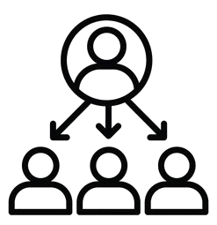
03
Real-World Impact Across Stakeholders

Slide 9



Who Benefits from Our System?
Dentists
➤ Use AI-assisted diagnostics to reduce manual workload
➤ Faster Diagnosis – AI speeds up the analysis of dental X-rays, reducing patient wait times. ➤Comprehensive Patient Reports – Generates structured dental summaries that aid in treatment planning.
Students ➤ Allows dental students to practice with real X-rays and receive immediate model-based feedback. ➤ Helps students visualize and learn how diseases and anomalies appear in dental X-rays. ➤ Integrated quizzes and model predictions support interactive learning.
Forensic Experts
➤ Identify in Crimes & Disasters – Use dental traits when other identifiers are missing or damaged.
➤ Age & Gender information
assists in identifying unknown individuals using X-ray traits.

Slide 10

04
Related Work

Slide 11
Related Work
🧪 Overview of Previous AI Models in Dental Imaging:
1️⃣ Gender Detection
Traditional ML models SVM and KNN (2017–2018) achieved 71 and 78.5% accuracy
CNNs like VGG16 (2020) improved results up to 94.6% accuracy
2️⃣ Age Group Detection
CNN and AlexNet-based models (2020–2022) achieved 73% and 84% accuracy
3️⃣ Teeth Disease Detection
YOLOv4 model (2024) showed strong performance (up to 90.9% accuracy) ,
but yet lacked precise segmentation and high false positives .
4️⃣ Tooth Detection and Numbering
CNN and YOLOv4 models (2023) reached up to 88.0% accuracy, but YOLOv4 still showed high false positives and struggles with overlapping teeth

Slide 12
Related Work (Cont.)
⚠️ Gaps in Prior Studies:
🔸 Low Accuracies in Core Tasks Many previous models achieved low accuracies, limiting clinical reliability.
🔸 Outdated Architectures Relied on ML and older models like AlexNet and basic CNNs, lacking transfer learning and modern
CNN Architectures
🔸 Lack of Segmentation Detection-only methods (e.g., YOLOv8) in Diseases Detection and not provide Segmentation.
🛠️ How Our Project Improves Over Existing Work:
1. Better Model Choice Uses modern CNNs Architectures for stronger learn.
2. Higher Accuracy Reduces false positives and improves detection rates.
3. Better Preprocessing Applies advanced Preprocessing techniques.
4. Transfer Learning Applies pretrained weights to boost results with limited data.
5. Real-Time Segmentation YOLOv8-seg use pixel-level masks for accurate disease detection

Slide 13

05
Datasets & Tools

Slide 14
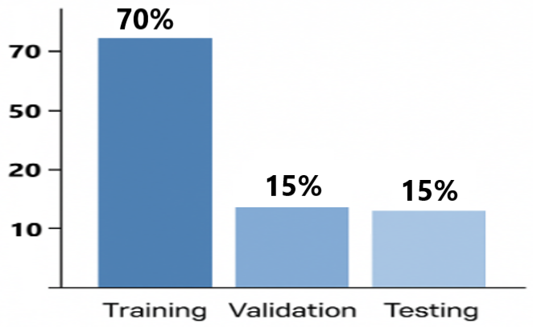
Datasets Information
Datasets Details:
Task | Dataset Name /Source | Sample Size | Classes / Labels
Gender Classification | Gender-labelled Panoramic Dental X-ray | 1,979 images | Male, Female
Age Group Classification | 1-Children’s Dental Panoramic Radiographs 2-Supplementary Pediatric X-rays | 3,436 images | Child, Adult
Tooth Numbering | Tooth Numbering Dataset | 2,528 images | 32 Teeth (Universal Numbering)
Disease Detection | Dental Disease Dataset (YOLO format) | 5,543 images | 10 Diseases Types
Each dataset was split into:
Training (70%)
Validation (15%)
Testing (15%)

Slide 15









Tools & Technologies
Programming: Python
Common Python Packages: TensorFlow, Keras, YOLOv8 (Ultralytics)
Development Platforms:
Colab
Kaggle
GPU: NVIDIA Tesla T4 GPU used
Web Technologies:
Frontend: React.js
Backend: .NET Core
Database: SQL Server
Models Deployment: Hugging Face
Backend Hosting: Monsterasp.net
Frontend Hosting: Netlify

Slide 16

06
Age Group & Gender Classification Models

Slide 17
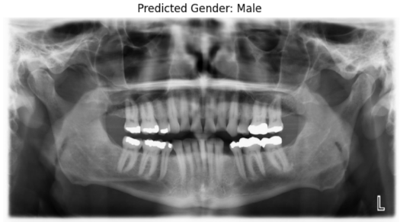
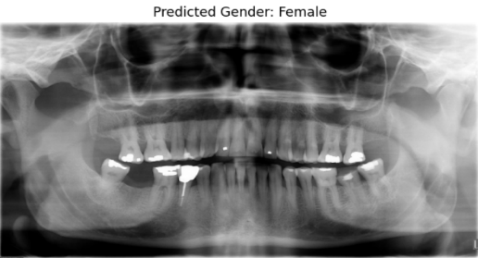
Models Overview
🚻 Gender Detection Model
Goal: Binary classification Task Classify a dental X-ray as Male or Female
Models Used: CNN Based Models : DenseNet121, InceptionV3 , VGG16
Input Panoramic dental X-ray
Output: Gender label → 🧔 Male or 👩 Female

Slide 18
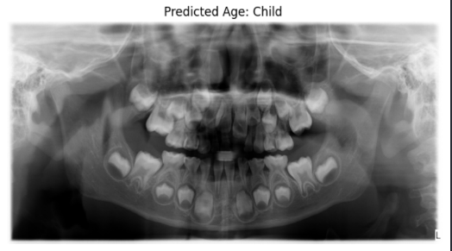
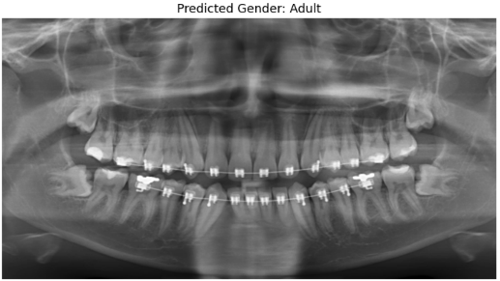
Models Overview (Cons.)
🦷 Age Group Detection Model
Goal: Binary classification Task Determine a dental X-ray as a Child or an Adult
Models Used: CNN Based Models : DenseNet121, InceptionV3 , VGG16
Input: Panoramic dental X-ray
Output: Age group → 👦 Child or 🧑 Adult

Slide 19
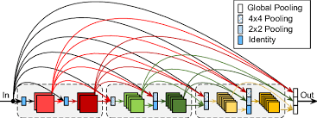
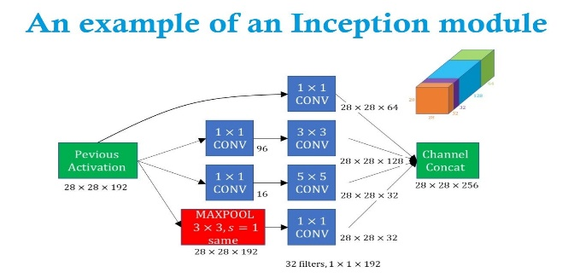
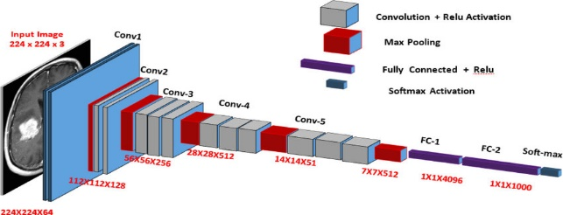
Architectures Used
DenseNet121
➤ Utilizes dense connections, where each layer receives inputs from all previous layers
➤ Reduces the number of parameters while improving gradient flow and feature reuse
Why Selected:
➤ Performs well on small and imbalanced datasets like dental X-rays.
➤ Efficient and robust in learning subtle features in medical images
InceptionV3
➤ Uses Inception modules with multiple filter sizes (1×1, 3×3, 5×5) in parallel
➤ Incorporates factorized convolutions to reduce computation resourses
Why Selected:
➤ Great at capturing multi-scale features from complex images
➤ Offers a balance of accuracy and computational efficiency, ideal for clinical deployment.
VGG16
➤ Contains 16 layers (13 convolutional + 3 fully connected)
➤ Uses 3×3 convolutional filters with fixed padding and stride throughout
Why Selected:
➤ Well-established architecture with high accuracy in classification tasks
➤ Easy to fine-tune and adapt
using transfer learning for medical images

Slide 20
Why Transfer Learning in Dental AI?
🔁 Transfer learning :
when using a pretrained model, trained on a large dataset for smaller dataset task. In this process, early layers are often frozen to preserve their learned features,
while later layers are fine-tuned on the new dataset to adapt to the specific
problem
Why Transfer Learning?
📉 Small Medical Dataset Challenge
Medical imaging datasets are often limited in size and variation, making it difficult to train deep neural networks from scratch.
🧠 Pretrained Knowledge Boost
Transfer learning allows us to reuse powerful feature representations learned from large-scale datasets like ImageNet, helping the models quickly adapt to dental features.
⚡ Faster and More Accurate Training
Using pretrained models like VGG16, DenseNet121, InceptionV3, and YOLOv8: • ⏱️ Reduces training time • 🎯 Improves accuracy and generalization • 🛡️ Prevents overfitting on small medical datasets

Slide 21
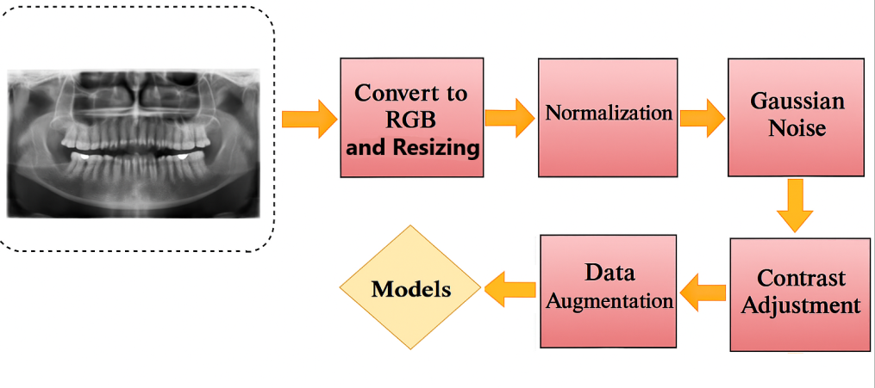
⚙️ Data Preprocessing
🔹 Image Preparation
Resizing
All X-ray images resized to 224 x224:Ensures and compatibility with pretrained CNNs based Models
Normalization [0–1] Stabilizes and speeds up training by standardizing pixel intensity.
Contrast Adjustment (0.9–1.1) Simulates variations in X-ray exposure and enhances contrast between dental structures.
Gaussian Noise(0.01–0.03) Introduces realistic noise to improve model robustness under imperfect imaging conditions.
🔹 Data Augmentation
Rotation (±5°) Mimics natural variation in head tilt during X-ray acquisition.
Right & Left Shift (±2%) To detect features even if slightly off-center.
Zoom & Shear (±2%) Improves generalization by varying spatial structure slightly.
Brightness Range (0.95–1.05) Accounts for lighting variability in real-world clinical settings.
f

Slide 22
Models Performance
📊 Gender Classification– Model Results
Model | Accuracy (%) | Precision | Recall | AUC Score
DenseNet121 🏆 | 97% | 0.96 | 0.96 | 0.95
VGG16 | 95.6% | 0.92 | 0.92 | 0.97
InceptionV3 | 93.59% | 0.92 | 0.92 | 0.95
📊 Age Group Classification– Model Results
Model | Accuracy (%) | Precision | Recall | AUC Score
VGG16 🏆 | 94.85% | 0.95 | 0.94 | 0.98
InceptionV3 | 91.75% | 0.92 | 0.93 | 0.97
DenseNet121 | 90.72% | 0.90 | 0.91 | 0.94

Slide 23

07
Teeth Detection, Numbering
& Disease Detection Models

Slide 24
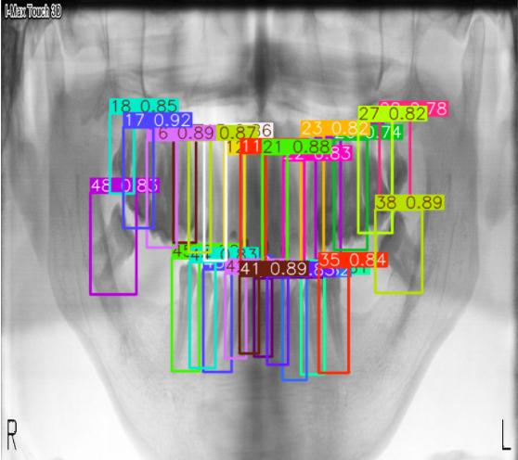
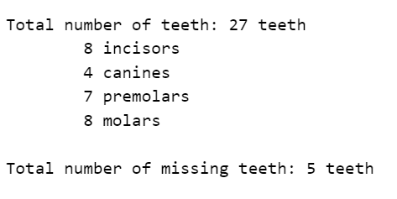
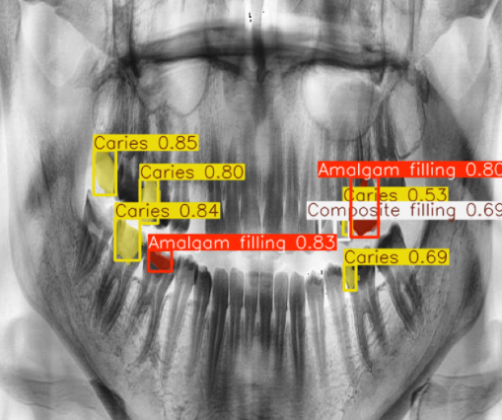
Models Overview
🔢 Teeth Counting Model (YOLOv8)
1.This model detects individual teeth in panoramic dental X-rays using object detection. 2.It outputs bounding boxes around each tooth and identifies missing or misaligned ones.
Output :Total number of teeth: includes numbers of ( Incisors ,Canines , Premolars and Molars)
🦠 Disease Detection Model(YOLOv8_Seg)
1.The disease detection model identifies and segments various dental
conditions and diseases directly from panoramic X-ray images. 🎯 Targeted Diseases:['Caries’, 'Crown’, 'Amalgam filling',
'Composite filling’, , 'Filling', 'Implant', 'Periapical lesion’ ,
'Retained root’, 'Root canal filling', 'Root canal obturation']

Slide 25
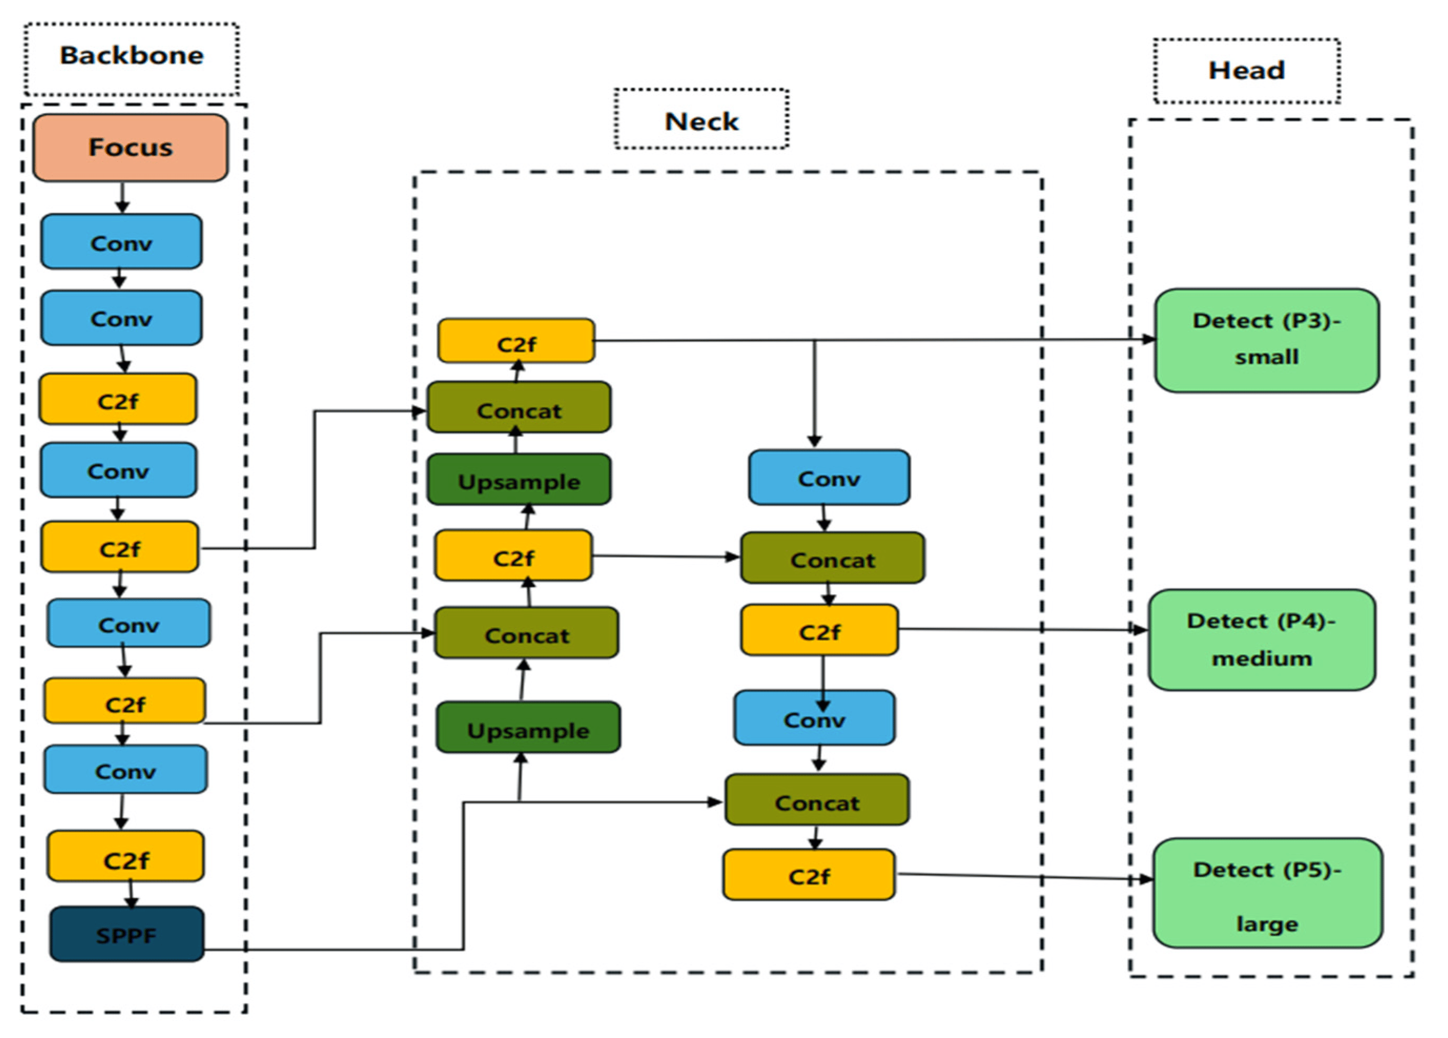
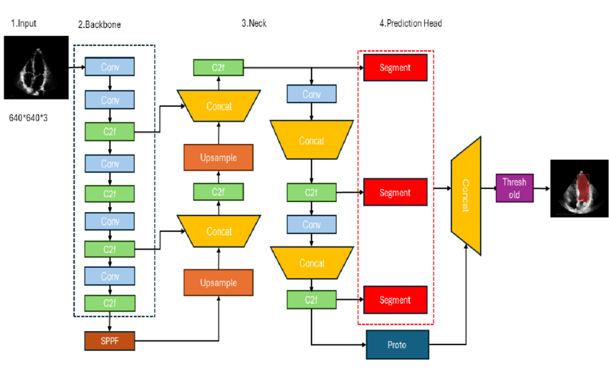
Architecture Used
YOLOv8
➤ A fast and lightweight object detection model
YOLOv8s has ~130 layers
➤ Has Three main Components :
Backbone ➝ Neck ➝ Head
Why Selected:
➤ Real-time detection speed
➤ High accuracy in detecting small and overlapping objects
➤ Lightweight enough for web deployment
YOLOv8-seg
➤ YOLOv8-seg is an advanced real-time object detection and segmentation model, YOLOv8-Seg-s: ~140 layers
➤ Unlike standard object detectors, YOLOv8-seg
provides pixel-wise segmentation of diseased regions
Why Selected:
➤ Offers high precision and speed for multi-class segmentation
➤ Ideal for identifying fine, overlapping
abnormalities in complex dental X-rays

Slide 26
🔹 Image Preparation
Resizing
All X-ray images resized to 640x640:Ensures and compatibility with YOLO
Normalization [0–1] Stabilizes and speeds up training by standardizing pixel intensity.
Contrast Adjustment (0.9–1.1) Simulates variations in X-ray exposure and enhances contrast between dental structures.
Gaussian Noise(0.01–0.03) Introduces realistic noise to improve model robustness under imperfect imaging conditions.
🔹 Data Augmentation
Rotation (±5°) Mimics natural variation in head tilt during X-ray acquisition.
Right &Left Shift (±2%) To detect features even if slightly off-center.
Zoom & Shear (±2%) Improves generalization by varying spatial structure slightly.
Brightness Range (0.95–1.05) Accounts for lighting variability in real-world clinical settings.
⚙️ Data Preprocessing
f

Slide 27
Results
📊 Teeth Detection & Numbering Model-Results
Metric | Value
Precision | 93.2%
Recall | 92.7%
mAP@0.5 | 96.7%
📊 Diseases Detection Model-Results
Metric | Box Value | Mask Value
Precision | 90.6% | 85.5%
Recall | 91.1% | 80.8%
mAP@0.5 | 80.0% | 79.1%

Slide 28
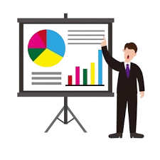
08
08
Best Results &
Comparative Analysis

Slide 29
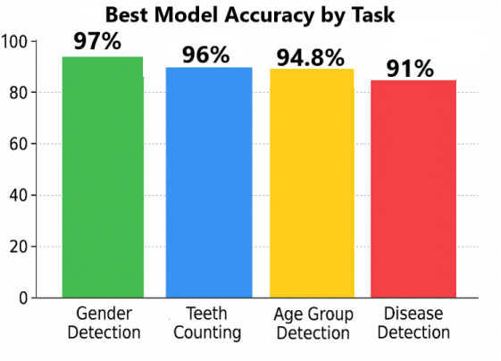
Best Results
🏆 Best Results from Our Study:
Our models achieved excellent results across all tasks.
DenseNet121 performed best for Gender classification , reaching 97% accuracy.
VGG16 performed best for Age group classification, reaching 94.8% accuracy.
YOLOv8 model for Teeth counting achieved a high mAP@0.5 of 96.7%,
YOLOv8-seg delivered strong Diseases segmentation performance 91.1% recall, 90.6% precision
mAP@0.5 is 80%

Slide 30
Comparative Analysis
📊 Performance Comparison: Our Models vs Literature
Task | Best in Literature | Our Best Model
Gender Detection | 94.6% (VGG16 + MFF, 2020) | 97% (DenseNet121)
Age Group Detection | 84% (AlexNet + k-NN, 2022) | 94.4% (VGG16)
Teeth Counting | 90.45% (VGG16, 2019 - static CNN) | 96.7% mAP@0.5 (YOLOv8)
Disease Detection | 90.9% Accuracy | 91.1% Recall, 90.6% Precision ,80.0% mAP@0.5
✅ Summary of Improvements Over Previous Work:
🔹 1. Higher Accuracy Across All Tasks
Achieved significant accuracy gains in all four tasks compared to prior benchmarks
🔹 2. Modern Architectures & Transfer Learning
Utilized advanced CNNs and pretrained models to improve learning efficiency and performance
🔹 3. Enhanced Data Handling & Preprocessing
Applied robust data augmentation and preprocessing to improve model generalization
🔹 4. Real-Time & Fine-Grained Segmentation
Integrated YOLOv8-seg for accurate, pixel-level detection of teeth and diseases in real-time

Slide 31

09
Web Application

Slide 32
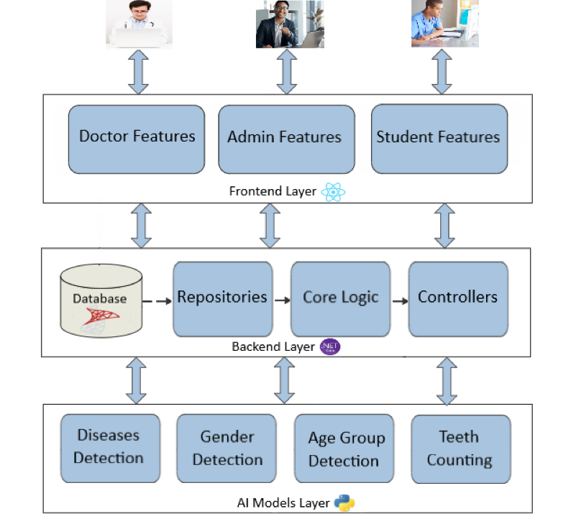
System Architecture
🖥️ 1. Frontend Layer (React.js)
The user-facing interface built with React.js that enables secure, role-based access to features like image upload, AI result display, and patient management.
🛠️ 2. Backend Layer (.NET & SQL Server)
The system’s core logic and API layer built with .NET Core, managing authentication, data storage, AI integration, and user roles.
🧠 3. AI Models Layer
The machine learning layer hosting deep learning models that analyze dental X-rays and return predictions via RESTful APIs.

Slide 33
System Features
👤 All Users (Admin, Doctor, Student)
Log in and authenticate using email/password (JWT-based access).
Upload dental X-rays and execute AI models (age, gender, teeth, disease).
Access features and services based on subscription status and plan.
Make payments, renew subscriptions, and receive system notifications.
🛠️ Admin
Manage users and roles (Doctors, Students, Admins).
Control plans, subscriptions, and review payment activities.
Create and organize quizzes, questions, and system-wide updates.
Monitor logs, access all data, and configure platform behavior.
🩺 Doctor
Manage patients and their medical histories.
Run AI scans, store results, and export diagnostic reports.
Access past diagnoses and handle plan-based access.
🎓 Student
Run AI models for learning purposes.
Subscribe to plans and access training features.
Take quizzes and receive instant feedback.
Update profile and receive system notifications.

Slide 34
Web Application – Architecture Details
Frontend: React.js
Built with React.js for a responsive
and modern UI Features: ➤ Login for Admin, Doctor, and Student users using email and password ➤ Upload dental X-ray images (JPEG, PNG, JPG) and execute four AI models ➤ Display AI-generated results (Gender, Age, Teeth Count, Diseases) ➤ Role-based access: Doctors manage patients; Students take quizzes ➤ View patient history (Doctors) and model usage history ➤ Export diagnostic results as downloadable PDF reports ➤ Take and score quizzes (Students only)
Backend: .NET Core
RESTful API built using ASP.NET Core Responsibilities: ➤ Handles user authentication and role-based access using JWT ➤ Validates uploaded X-rays and routes them to correct AI model ➤ Connects to Hugging Face APIs for age, gender, disease, and tooth count detection ➤ Enforces subscription plan rules (e.g., Premium, Institutional) ➤ Manages all user types (Admin, Doctor, Student) and their permissions ➤ Stores and retrieves data (users, results, history, scores)

Slide 35

Web Application – Architecture Details (Cont.)
Model Hosting: Hugging Face
All AI models deployed as APIs via
Hugging Face Spaces ➤ Models provide real-time results for age, gender, disease, and teeth counting tasks
Database: SQL Server
Structured relational database Stores: ➤ User account details and roles ➤ Metadata of uploaded X-ray images ➤ AI-generated diagnostic outputs ➤ Medical records and patient history (Doctors) ➤ Quiz results and scores (Students) ➤ Subscription plan details and validation info
Server Hosting: Monsterasp.net
Full backend deployed to Monsterasp.net
for public access Provides: ➤ Hosting of secure .NET Core API endpoints ➤ Communication between frontend and AI model services ➤ Scalable deployment supporting user sessions and data flows
Client Hosting: Netlify Full frontend deployed to Netlify for
fast and secure public access Provides: ➤ Hosting of the React.js web application ➤ Seamless connection to backend APIs via HTTPS ➤ Continuous deployment from Git with high availability and speed

Slide 36

10
Conclusion & Future Work

Slide 37
Conclusion & Future Work
🧾 Conclusion
This project successfully developed an AI-powered dental diagnostic system capable of performing four essential tasks:
Gender Detection (DenseNet121): 97% accuracy, 0.96 precision & recall
Age Group Classification (VGG16): 94.8% accuracy, 0.95 precision & 0.94recall
Tooth Identification & Numbering (YOLOv8): 96.7% mAP@0.5, 93.2% precision
Dental Disease Detection & Segmentation (YOLOv8-seg): 91.1% recall, 90.6% precision
A user-friendly, web-based platform was built to integrate all models, allowing real-time dental
diagnostics accessible to clinicians, researchers, and forensic experts.
🔮 Future Work
Expand datasets to include more diverse and annotated dental X-rays
Build a mobile app for portable, real-time dental assessments
Advanced Models Exploration like EfficientNet, Swin Transformer
Enhance Diseases Detection by support more diseases
Color images support for teeth to detect issues like gum or cavities
Add new user types such as Forensic Experts to support criminal investigations and identity verification

Slide 38
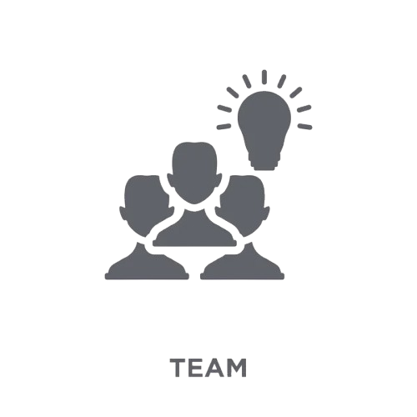
11
Meet our Team

Slide 39
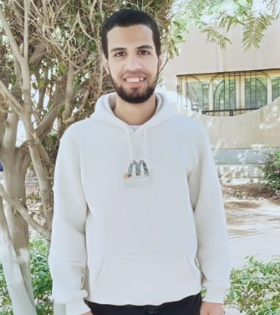


Jana Emad
Amr Gamal
Rehab Sayed
Mariam Saad
Kholod Sadek
Anderw Gamil

Slide 40
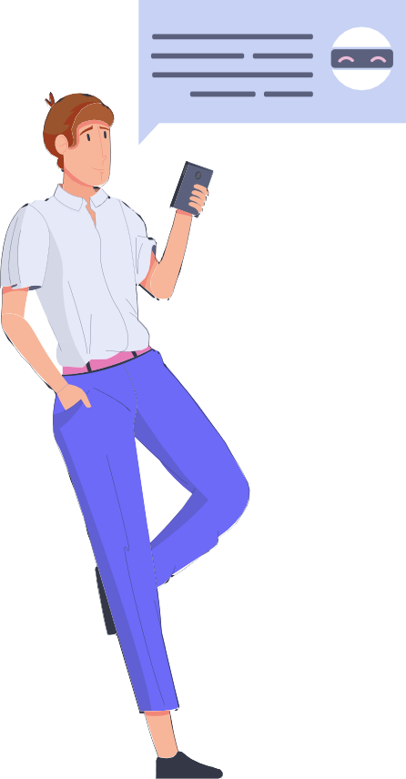
Thanks!
Any questions?

